Slide 1
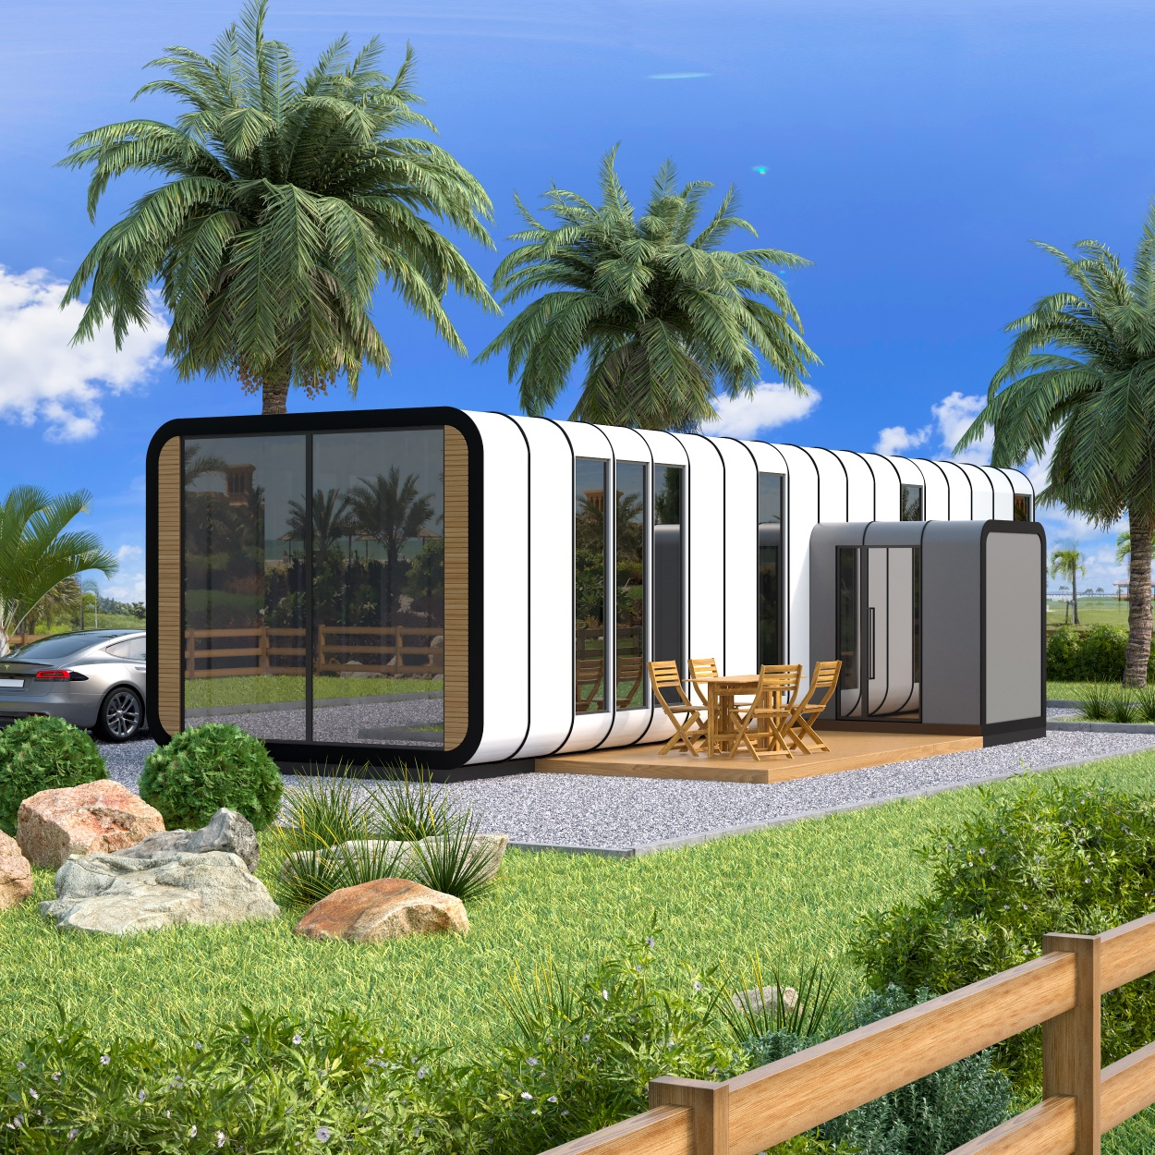
MADE BY EXPERTS

Slide 2
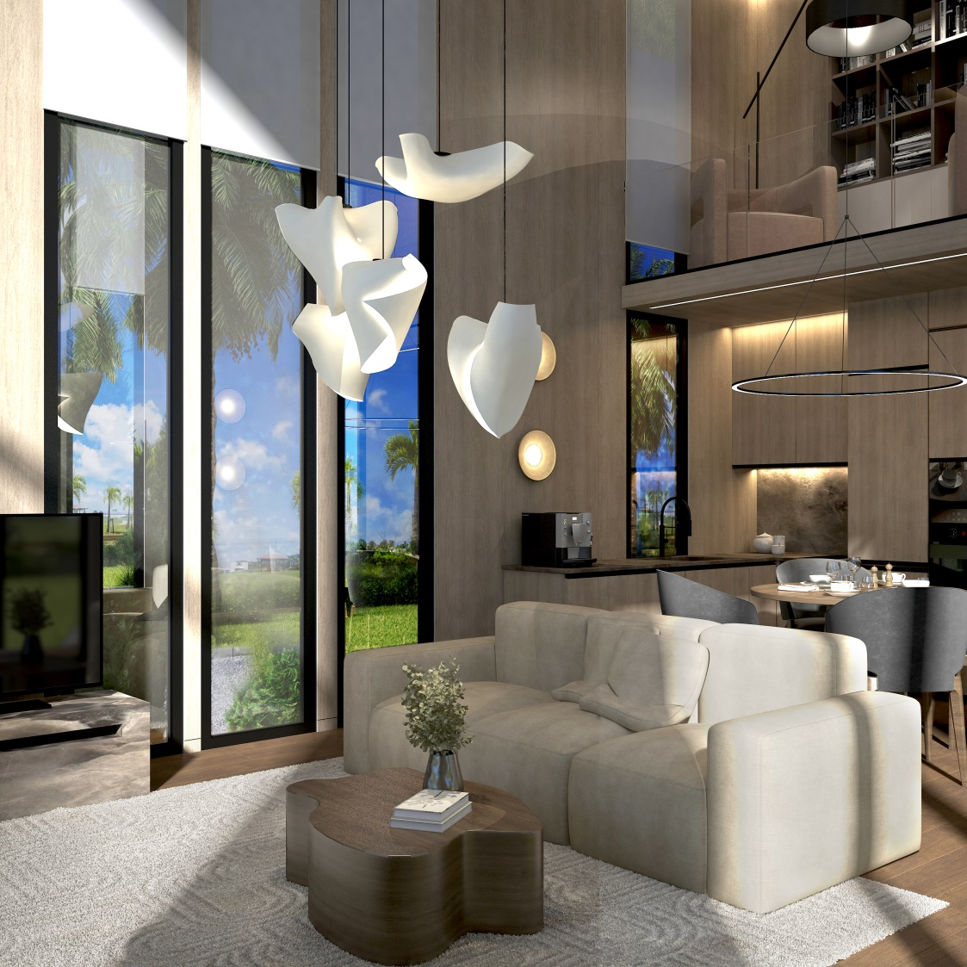
OUR MISSION
THE IDEA OF CREATING THE MODULEONE BRAND IS BASED ON THE PRINCIPLES OF THE AUTOMOTIVE AND AVIATION INDUSTRIES AND WAS BORN DURING 30 YEARS OF EXPERIENCE IN DESIGNING AND BUILDING PRIVATE HOUSES, RESIDENCES AND PERSONAL EXPERIENCE OF LIVING IN THEM.
WHAT IS THE PROBLEM OF MODERN CONSTRUCTION?
LONG DEADLINES
POOR QUALITY OF EXECUTION
HIGH COST
THE NEED TO REPAIR THE HOUSE AFTER OPERATION FOR 3-4 YEARS
HIGH MAINTENANCE COST
YOU CAN SOLVE THESE PROBLEMS TOGETHER, JUST READ AND REALIZE WHAT IS WRITTEN BELOW.

Slide 3
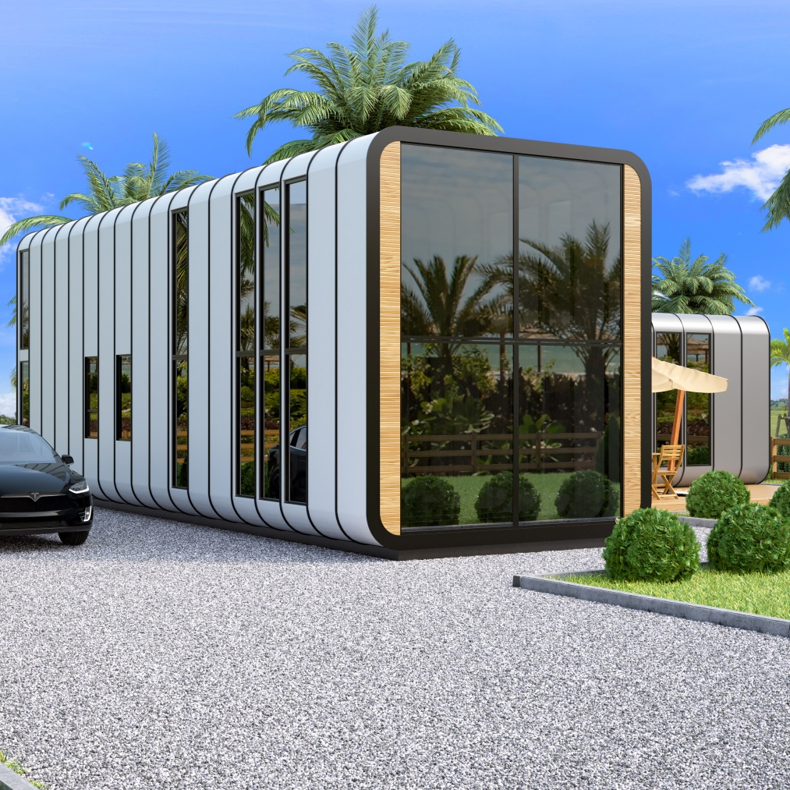
SOLUTION
MODULEONE homes are new trend. Our homes can give the average person their high quality dream home for fraction of the price.
Prefabricated homes are easy to relocate and can be used for variety of different
purpose.
Modular construction
provides solutions for many problems encountered
on site.
With approximately 80-90% of the
structure completed in the factory, there
are fewer delays from inspections and
bad weather at the building site.
The chance of material theft and vandalism
is minimized, fewer subcontractors
are needed to complete the project,
and stress upon the surrounding
community is significantly reduced.

Slide 4
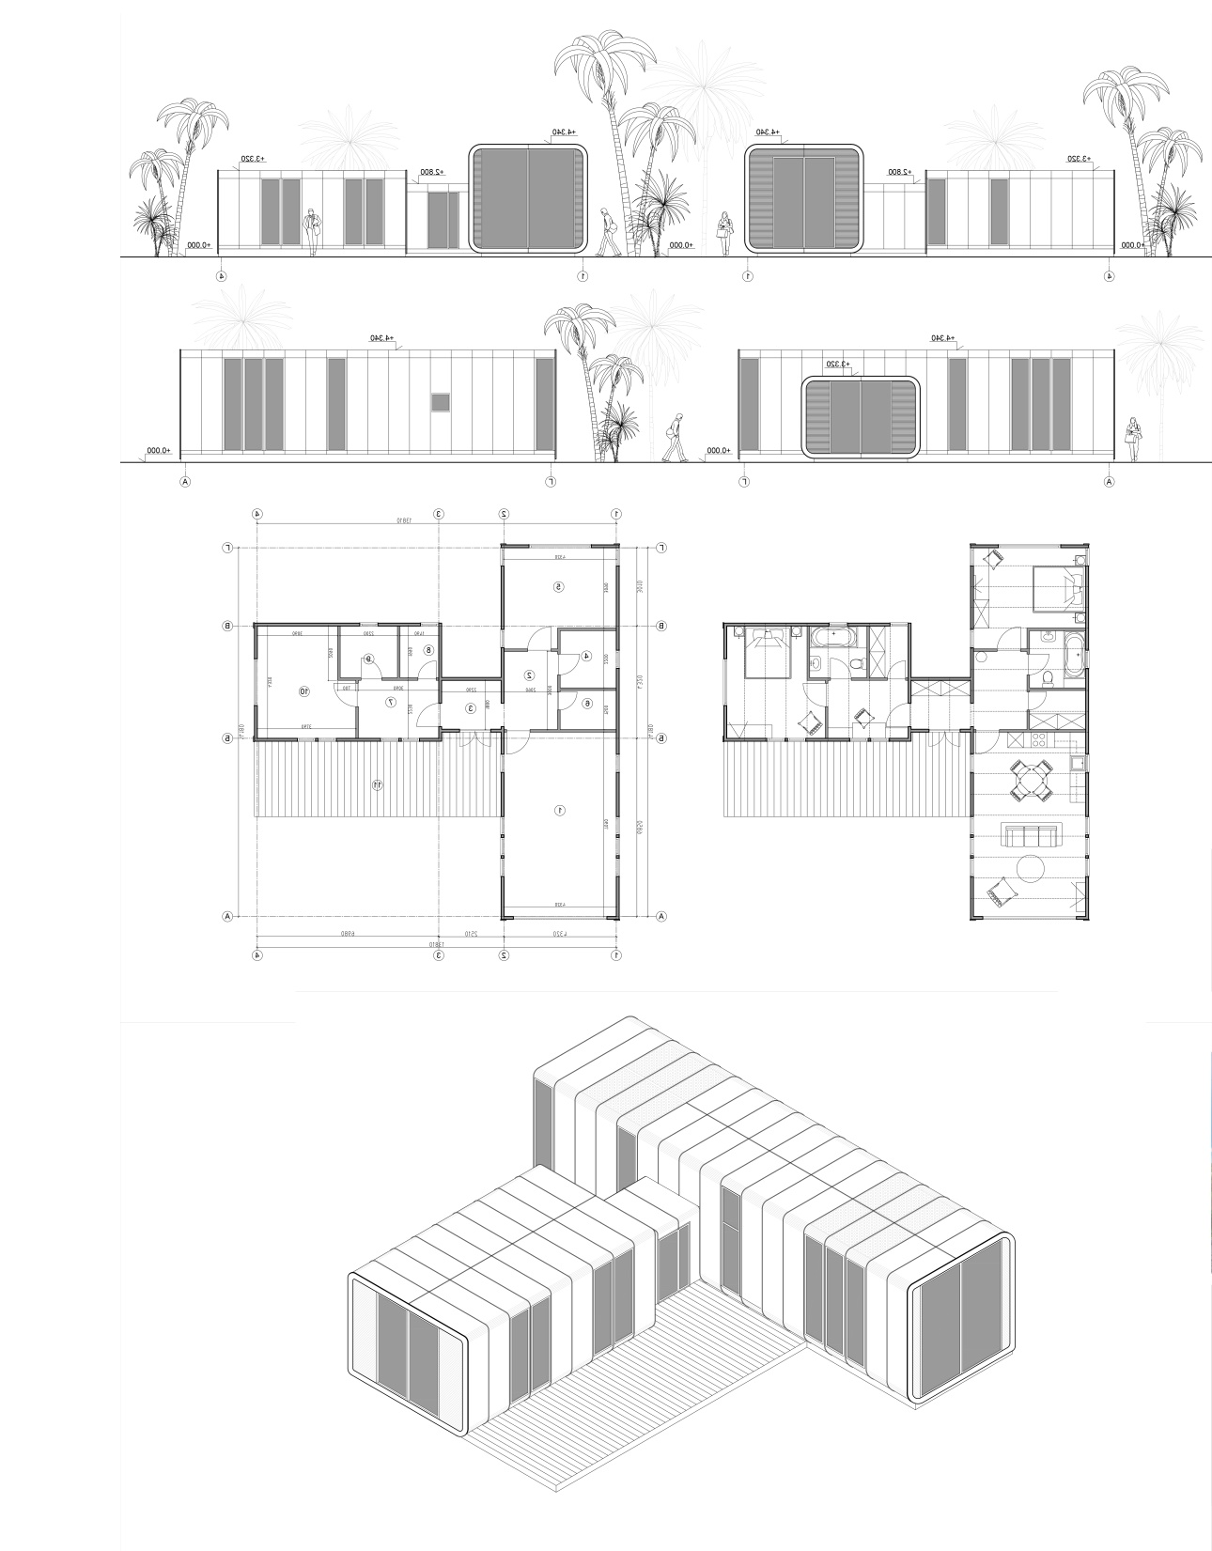
PRODUCTION FEATURES
OUR HOUSES ARE DIVIDED INTO SEGMENTS, WHICH ARE MANUFACTURED IN THE WORKSHOP ACCORDING TO PRODUCTION STANDARDS AND QUALITY CONTROL AT ALL STAGES. DURING THE PRODUCTION OF SEGMENTS OF THE HOUSE, INTERIOR DECORATION IS PROVIDED AS MUCH AS POSSIBLE, AFTER ASSEMBLING THE HOUSE ON THE SITE, ENGINEERING COMMUNICATIONS ARE INSTALLED IN SPECIAL CHANNELS THAT ARE PROVIDED IN THE SEGMENTS OF THE HOUSE, THE KITCHEN IS ASSEMBLED AND LIGHTING IS INSTALLED.
THE ENTIRE PROCESS OF ASSEMBLING A HOUSE ON THE SITE IS STANDARDIZED WITH COMPLETE STEP-BY-STEP INSTRUCTIONS, WHICH WILL ELIMINATE ERRORS DURING THE ASSEMBLY OF SUCH A HOUSE AS MUCH AS POSSIBLE AND RADICALLY REDUCE THE CONSTRUCTION TIME? THE ASSEMBLY OF THE HOUSE TAKES 20-30 DAYS, MOST OF WHICH THE MAIN TIME IS THE LAYING OF UTILITIES, THE CONSTRUCTION OF THE FOUNDATION AND THE FINAL COMMISSIONING OF THE HOUSE. ALL THE CONSTRUCTION OF THE HOUSE IS NOT CONNECTED WITH WET PROCESSES, IT ALLOWS YOU TO WORK ALL YEAR ROUND.
OUR HOUSES DO NOT REQUIRE REPAIR OF FACADES, DRAINAGE SYSTEMS, ROOFS. THE COATING OF THE HOUSE IS RESISTANT TO MECHANICAL DAMAGE AND UV RADIATION.IT'S LIKE YOU BOUGHT A CAR AND PARKED IT IN A LONG-TERM PARKING LOT.

