Slide 1
Project «Dairy «KameshCheese» on the base Kameshkir cheese factory

Slide 2
Location – Penza region, district center Russian Kameshkir, Kameshkir cheese factory
50 year history of cheese making
5 000 sq.m. production area
Cheese storage for simultaneous aging of 350 tons of cheese
All the necessary technological equipment, has its own smoker, own transport
Artesian wells, electric substation, gas
Convenient location-100 km from Penza, 200 km from Saratov, 340 km from Samara, 700 km from Moscow
Qualified and inexpensive staff

Slide 3
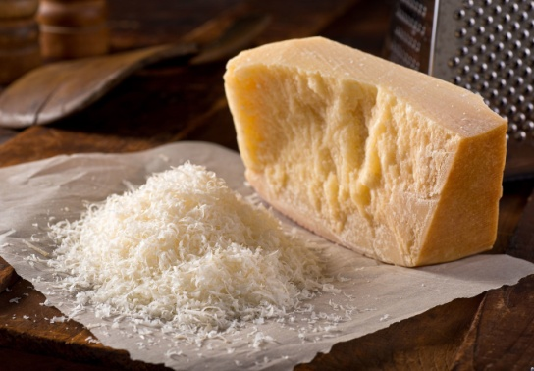
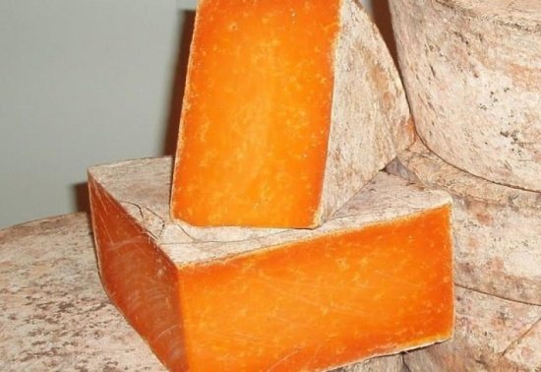
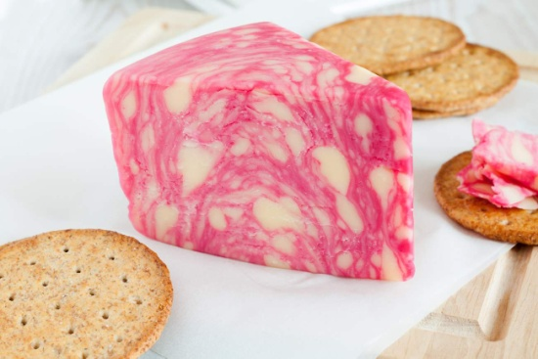
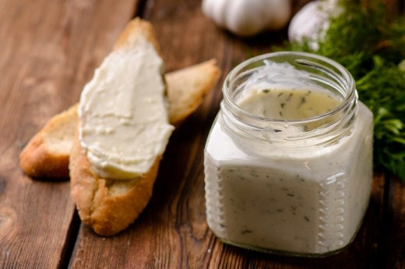
Only cheese – nothing but cheese!
Solid “Classic”
Solid “Exotic”
Semi-solid “Classic”
Semi-solid “Exotic
Soft cheese
Pickled cheese
Curd cheese
Whey cheese
Cream cheese

Slide 4
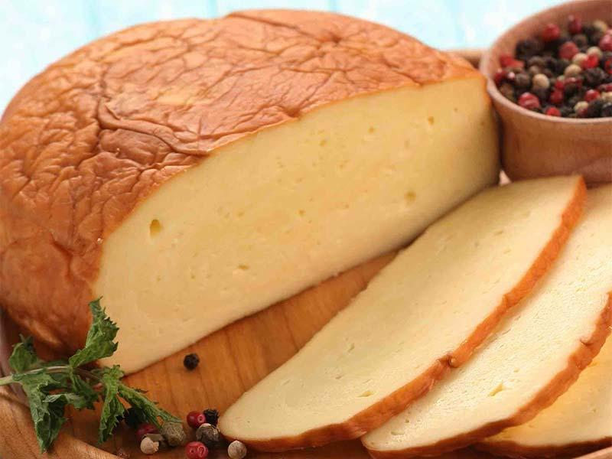
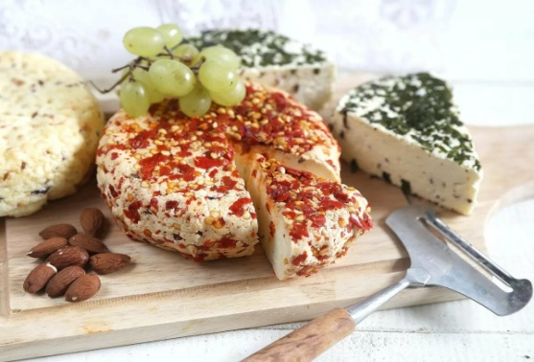
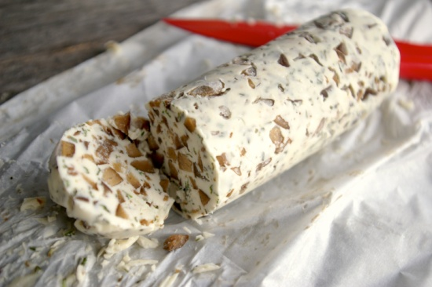
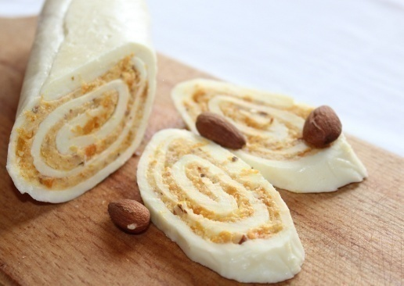
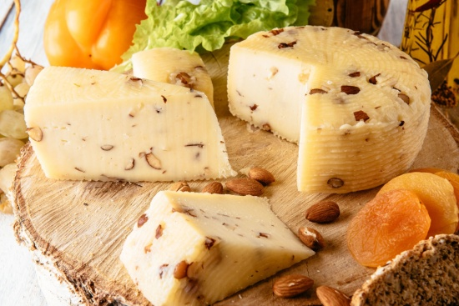
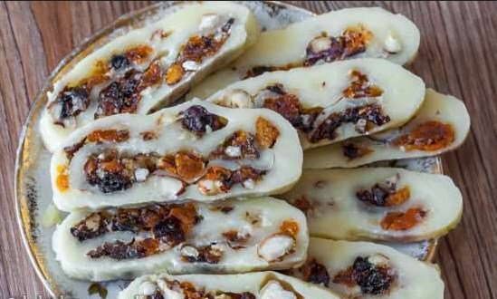
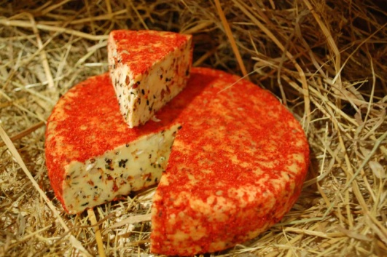
Только сыр – ничего кроме сыра!
Smoked cheese
Cheese roll in spices
Cheese in herbs
Flower-sprinkled cheese
Cheese with dried mushrooms
Cheese with dried apricots
Cheese with almonds
Cheese with dried fruits
Cheese with dried tomatoes

Slide 5
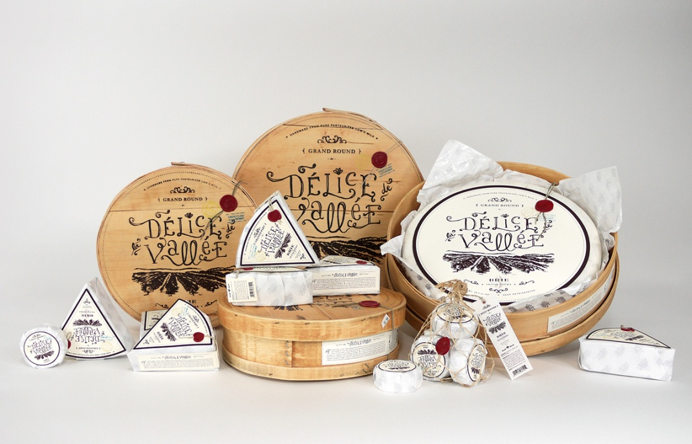
A wide range of shapes and weights!
A variety of beautiful packaging !
Shapes: briquette, puck, ball, cylinder, triangle, pyramid, cone, ring.
Weight:
7,5; 4,5; 1,5; 1; 0,8; 0,7; 0,5; 0,3; 0,2; 0,1; 0,05 kg

Slide 6
Sales channel
Direct purchase and direct order
A community of regular customers who buy cheese themselves and recommend it to their friends. Discounts, bonuses, gifts, events, the opportunity to order your own cheese.
Restaurants & Cafe
Convenient sizes, volumes, packaging, types of cheese needed for specific dishes .
Retail outlets in shopping centers
Visibility of the product range, brand promotion, sales in crowded areas of the target audience.
Delivery
"Gift sets of cheese", “Cheeses for the holiday", "Cheese plates and cheese baskets", “Sets for wine", "Sets for beer", "Tasting sets".
Franchising
After the project reaches a stable operating mode, a network of franchisees will be created in major cities of Russia and neighboring countries. Conditions for franchising partners: a lump sum of $ 5,000, which includes the brand, advertising materials, corporate SRM system, partner support, and the volume of products for $2,000. There are no royalties.

Slide 7
Revenue
In the first six months after the start of the project it is planned to produce
20 tons of products per month starting from the fourth month
Period from the project`s start | Up to 6 months | From 6 м. to 1 year | From 1 to 1,5 year | From 1,5 to 2 years | From 2 to 3 years | After 3 years
Production quantity Tons/month | 20,00 | 24,00 | 39,00 | 46,00 | 69,00 | 84,00

Slide 8
Revenue
The weighted average selling price of 1 kilogram of cheese is $ 11.4
Gross yield from 20 tons of products -11.4 x 20 000 = $ 228,000/ month
Gross cost of an average kilogram of products - 5.3 dollars
Gross cost of 20 tons of products - 5.3 x 20,000 = $ 106,000 / month
Gross margin profit is $ 122,000 / month.
Discount on raw materials and technology defects-5% of the VMP – $ 6,100
Monthly expenses (salary, payroll taxes , property taxes, rent, advertising,
utility expenses, manufacturing and overhead expenses) - $ 60,810.
2% of sales volume-sales motivation - $ 4,560.
Taxes – 6 % of sales - $ 13,680.
The monthly estimated profit of the project in the first six months
(starting from the fourth month) -$ 36,850

Slide 9
Revenue
Forecast profit schedule for the project

Slide 10
Risks
- risk of increase in purchase prices for raw materials and ingredients for cheese production / risk factor 0.2/
- risk of technical failures that extend the production period / risk factor 0.1/
- risk of equipment breakdowns in the course of production activities / risk factor 0.1/
- risk of manufacturing defects / risk factor 0.2/
- risk of failure to deliver ordered or paid goods / risk factor 0.1/
- risk of insufficient demand for products / risk factor 0.2/
- risk of force majeure (e.g. pandemic) / risk factor 0.1/
- risk of shortage of personnel reserves /risk factor 0.2/
- competition risk / risk factor 0.05/
- risk of delays in delivery of raw materials, ingredients, packaging /risk factor 0.1/
- risk of delivery of low-quality raw materials, ingredients, packaging or under-delivery / risk factor 0.2/
risk of loss of time during repair or installation work, transportation, training of personnel and formation
of technological processes / risk factor 0.2/
risk of insufficient project funding / risk factor 0.4/
To compensate for the impact of risk factors on the project indicators, dynamic risk discounting of the projected monthly
profit of the project is applied depending on the stage of project implementation. The most likely impact of risk factors is
assumed at the initial stages of the project, while by the time the project reaches its planned capacity, the impact of risk
factors is significantly reduced.
Period from the project`s start | up to 6 months | from 6 monts to 1 year | from 1 to 1,5 year | from 1,5 to 2 years | from 2 to 3 years | after 3 years
Risk discount rate | 50% | 35% | 25% | 15% | 10% | 5%
PMP | 36 850 | 53 950 | 119 606 | 151 238 | 256 209 | 325 983
PMP after risk discounting | 18 425 | 35 067 | 89 704 | 128 552 | 230 588 | 309 684

Slide 11
Development and profit
To ensure the growth of productivity and sales indicators, part of the project's profit must be reinvested in the project in order to create conditions for the project's growth ( creating additional jobs, purchasing new equipment, repairing premises, expanding the network of retail outlets, and so on). For this purpose, a dynamic reinvestment rate is applied, which discounts the main indicators of the project's planned profit using the following algorithm:
Period from the project`s start | up to 6 months | from 6 monts to 1 year | from 1 to 1,5 year | from 1,5 to 2 years | from 2 to 3 years | after 3 years
Risk discount rate | 50% | 35% | 25% | 15% | 10% | 5%
PMP | 36 850 | 53 950 | 119 606 | 151 238 | 256 209 | 325 983
PMP after risk discounting | 18 425 | 35 067 | 89 704 | 128 552 | 230 588 | 309 684
Graph of the project's discounted forecast monthly profit (DFMP)

Slide 12
Indicators
Project break-even point – 1 year 9 months
Doubling of initial investments – 2 years 11 months
More than $ 3.3 million –project`s discounted forecast
profit in three years
48 employment opportunities will be created at the start
204 tons of cheese will be produced in the project`s first year
More than 40 types of cheese-product range

Slide 13
Project financing
The total project estimate for investment purposes is $ 2,000,000 at the start of the project.
One investment share of the project is equal to 1% of the total estimated cost of the project and is estimated at $ 20,000.
The start of the project is carried out only after the availability of the entire required amount of investment financing, i.e. at least $ 853,330.
The profit is distributed among the project participants according to their share.
No more than 45% of the project shares can be distributed to the investor. 5% of the shares are reserved as options in order to further motivate key employees of the project team.

Slide 14
Project financing
Strategic investor
Who?
An organization or entrepreneur who is ready to invest in the project all the necessary amount for its launch – at least 850,000.
How?
Conclusion of a project strategic investment contract
45% share in the project
The right to appoint a representative to the position of financial Director (CFO) of the project.
Getting a share of the project's profit corresponding to the size of the investment share in the project.
The right to control any working and financial processes of the project at any time, and to receive any necessary reports from the project team.
The right to withdraw from the project at any time by selling your share to another investor.
The right to purchase a share by the project after the end of the project implementation period (3 years from the start of the project) at a pre-agreed price.
The right to an increased amount of return of invested funds from the project's profit until the payback point of the investment invested in the project is reached.

Slide 15
Project financing
Financial table of strategic investment (with an investment of $ 850,000)
Period from the project`s start | up to 6 months | from 6 monts to 1 year | from 1 to 1,5 year | from 1,5 to 2 years | from 2 to 3 years | after 3 years
DFMP | 18 425 | 22 793 | 71 763 | 83 559 | 184 470 | 309 648
% refund from DFMP per month | 12 898 (70%) | 15 995 (70%) | 50 234 (70%) | 58 491 (70%) | 129 129 (70% for first month of period) 83 011 (45% for next months of period) | 139 341 (45%)
Total % of refund from DFMP for the period | 38 693 | 95 731 | 301 405 | 350 948 | 1 042 250 | 1 672 099 (for 1 year after 3 years)
Thus, we see that the return on investment for a strategic investor will be achieved in 2 years and 1 month from the start of the project. In 2 years and 11 months, the amount of return on investment will double, that is, it will bring the investor about 30% per annum, and in 4 years from the start of the project, the amount of returned funds will reach $ 3.5 million, that is, almost four times higher than the initial investment.
Additional guarantee of return on investment - making a convertible loan. If desired, the investment contribution is issued as a loan to the project with the possibility of converting the loan amount into investment shares of the project at the end of the loan term. If the project is successful, the investor receives the corresponding shares of the project, if something went wrong, the loan amount is returned to him with interest. Interest on the loan is 5 % per annum. The loan is issued for 2 years. After this period, the strategic investor must decide whether to take the loan amount with interest or get a share in the project.

Slide 16
Project financing
The project team considers attracting project financing in the form of credit funds at a reasonable Bank interest rate. As security for the credit, it is possible to provide real estate and equipment of the Kameshkir cheese factory as collateral, as well as a guarantee from the founders of the project.
The project team will also be happy to consider other acceptable funding options for the project. Any additional information about the project, financial calculations, title and other documents can be provided by the project team to interested parties upon request.
Thanks for your attention!

