Slide 1
чай Point
Pitch Deck

Slide 2
About Us
We are a Chain of Worlds most drank Liquid that is CHAI. We bring perfectly brewed Indian Chai made with Fresh & Natural Ingredients that has health benefits. We bring range of Indian organics products and Indian artifacts. We use bio degradable clay cups and items only.
A mini retail store for the customers to buy on the shelf Indian tea blends, Spices, Indian super-food and artifacts
Catering our products to the people of Saint Petersburg, Russia

Slide 3
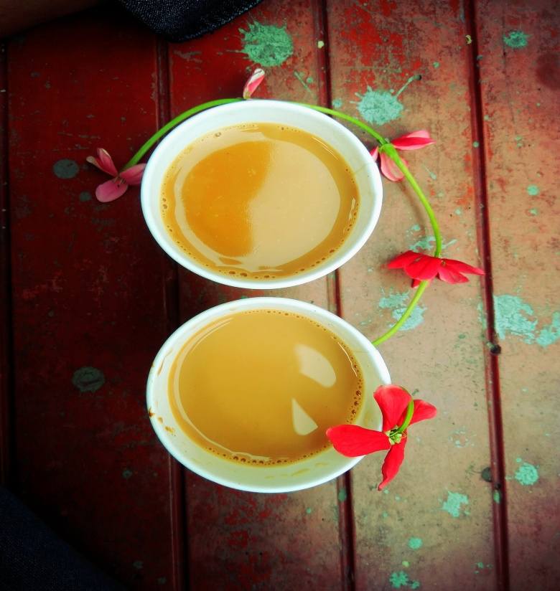
Vision
To become Russia’s one of the Renowned Hot/Cold beverage chain catering in various Indian Tea blends and making access to Indian super food and other Artifacts.
Mission
To Provide Authentic healthy Indian Tea blends, Indian Super food, Spices right to your door step.

Slide 4
The Team
Irena Pandey
Operations Head Russia
Irena, Expert in Russian market with 5+ years of experience handling various fields in beauty and aviation tourism. With background in Civil aviation and Law.
Stanislav Vitushinski
Director AGAT LLC
Director of AGAT LLC in collaboration with us for tourism in URAL, North pole and Manpupuner. Handles helicopter rides and expedition. Holds 15+ years experience in arranging tours and expedition.

Slide 5
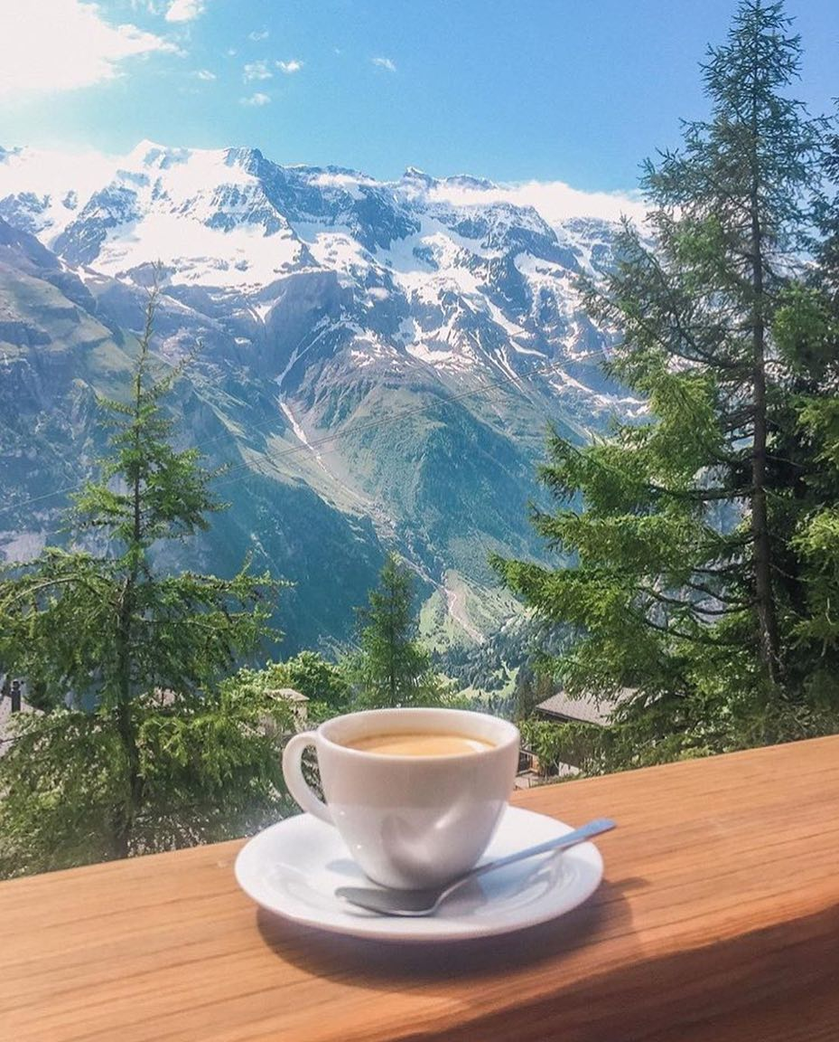
The Problem
There is actually no problem, Chai is the solution to every problem. In worries, have a Cup of tea, Sip the health benefits and bring your senses to peace.

Slide 6
Our Answer to your prayers
We provide two Solutions:
Authentic Indian Tea blends with other Indian products on the shelf.
Indian Super food and Artifacts.
Retails on the Go items.

Slide 7
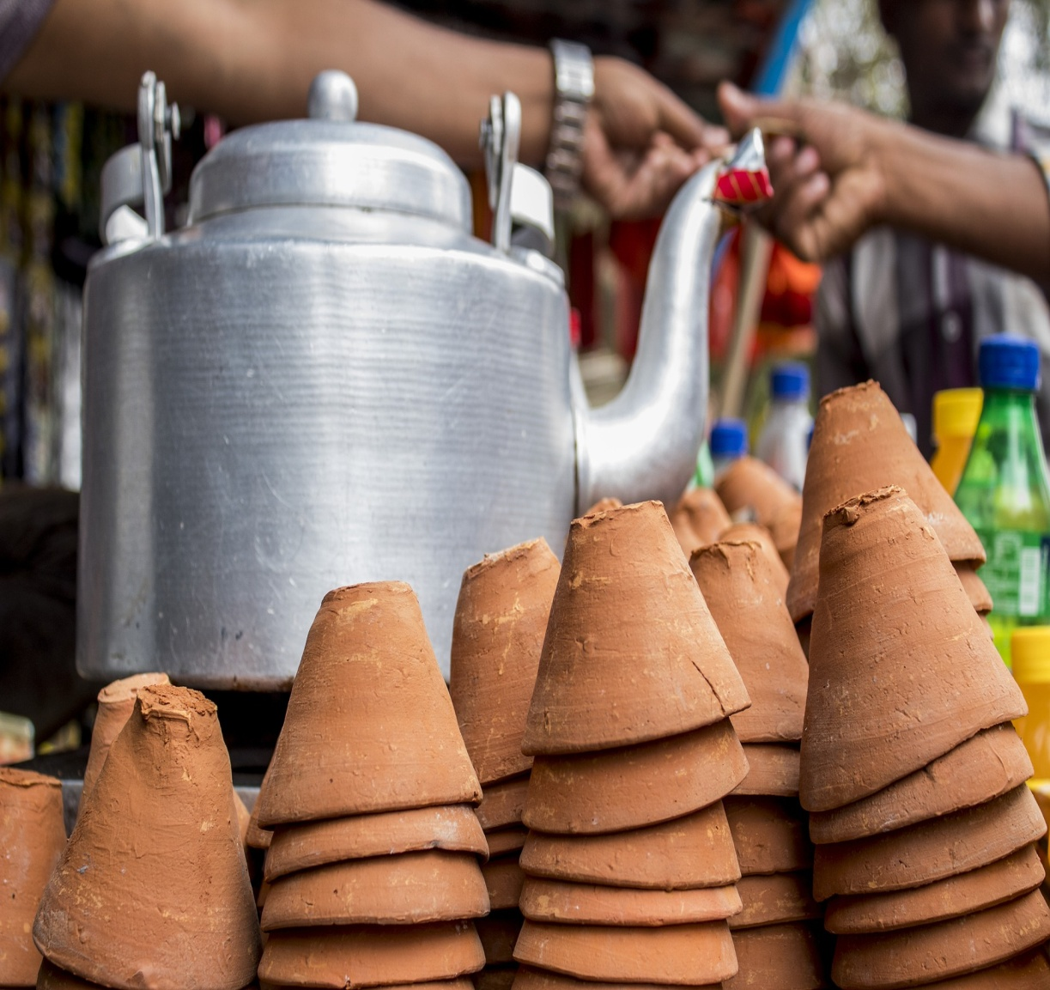
Indian Tea
Our concept is to inject Indian Tea culture in to Russian market with our range of blends in Tea like Masala, Ginger, Cardamom and many more.
With these blends, health benefits will be our key focus.
Many other Indian products like Organic food and Super food items from Beunosh, Indian spices and artifacts that will added delight in our range.
All our serving products are organics and Bio degradable like the clay cups, bamboo straw, degradable spoon and fork.

Slide 8
Ready to Hit the Market
We are ready to hit the dance floor with our products. We are in collaboration with tea blends provider “Sattava” and organic foods items from established brand like “Beunosh”. Indian artifacts are provided direct from the vendors.
Strategic location for the stall to be installed have been identified. Galleria Mall, Ohta Mall, London Mall etc in Saint Petersburg.
In touch with Indian embassy for recognize support.

Slide 9
Expand the Cult
We will also provide franchise option to interested parties across Russia.
Since the model of business is profitable and ever green people in franchise will have a good return.
With our Cult of tea we would also generate employment for people in need.

Slide 10
Traction
“In 2019, a record-breaking number of tourists, 9.1 million people, visited St. Petersburg in 2019, TASS reports citing Yevgeny Pankevich, Chairman of the St. Petersburg Committee for tourism development.– topspb.tv”
Saint Petersburg being the cultural hub of Russia is visited by tourist extensively and the number is increasing exponentially as the visa policy have become more flexible.
Chai being a popular drink is drank all over the country and the Russian market is fond of Indian tea blend and products. Influenced with European culture its a trend to have tea after lunch and dinner. Malls, Office, Universities and Govt building are popular destination for grab a cup of tea.
Indian Artifacts are extensively used for Interior decoration and with Russians having a classic taste in interior design this is a sure take for them.

Slide 11
Profit Margin
With tea and other ingredient are directly supplied from India the cost of material is low.
For Tea, the profit margin is 5x to 7x times more than the cost of one cup of tea.
Ex. 1 cup cost to us = 20 ruble
1 cup sold in market for 100 to 120 rubles
For Super Food and Organic items the Profit margin
goes upto 70 to 110%.
Looking at the large market for the Spices,
it can be directly supplied to retailers,
restaurants and malls.

Slide 12
Investing
In order to officially begin, the company will require a budget estimated between $40,500 in the market with 2 stalls in Saint Petersburg .
These 2 Stall will be combined stall both for Chai and retail products.
Investment will be channeled for the Raw material, Infrastructure,
Promotion and staffing.
Shopping mall and Business location to be installed with Stalls.
Partners and Vendors ready for installations.
Stall inquiry and request received from Crimea, Rosa-khutor and Moscow.
and will be collected from the following sponsors : This budget will be utilized as follows :
40%
Starting Capital
20%
Furniture
10%
Employee Salaries
10%
Ingredients
10%
Rental Fee
10%
Promotion

Slide 13
Business Model
Key Activities: Managing authentic taste and materials. Promoting the tea culture and activities. Promoting Indian super food and Artifacts.
Key Resources: Physical tea kitchen and counter for retail. Online platform for overall recognition.
Channels: Online website for Tea and products Android/IOS app, Third party platform like Delivery, Yandex.
Value proposition: All products are priced reasonable and have health benefits.. Work with us Full/Part time , Flexible time.

Slide 14
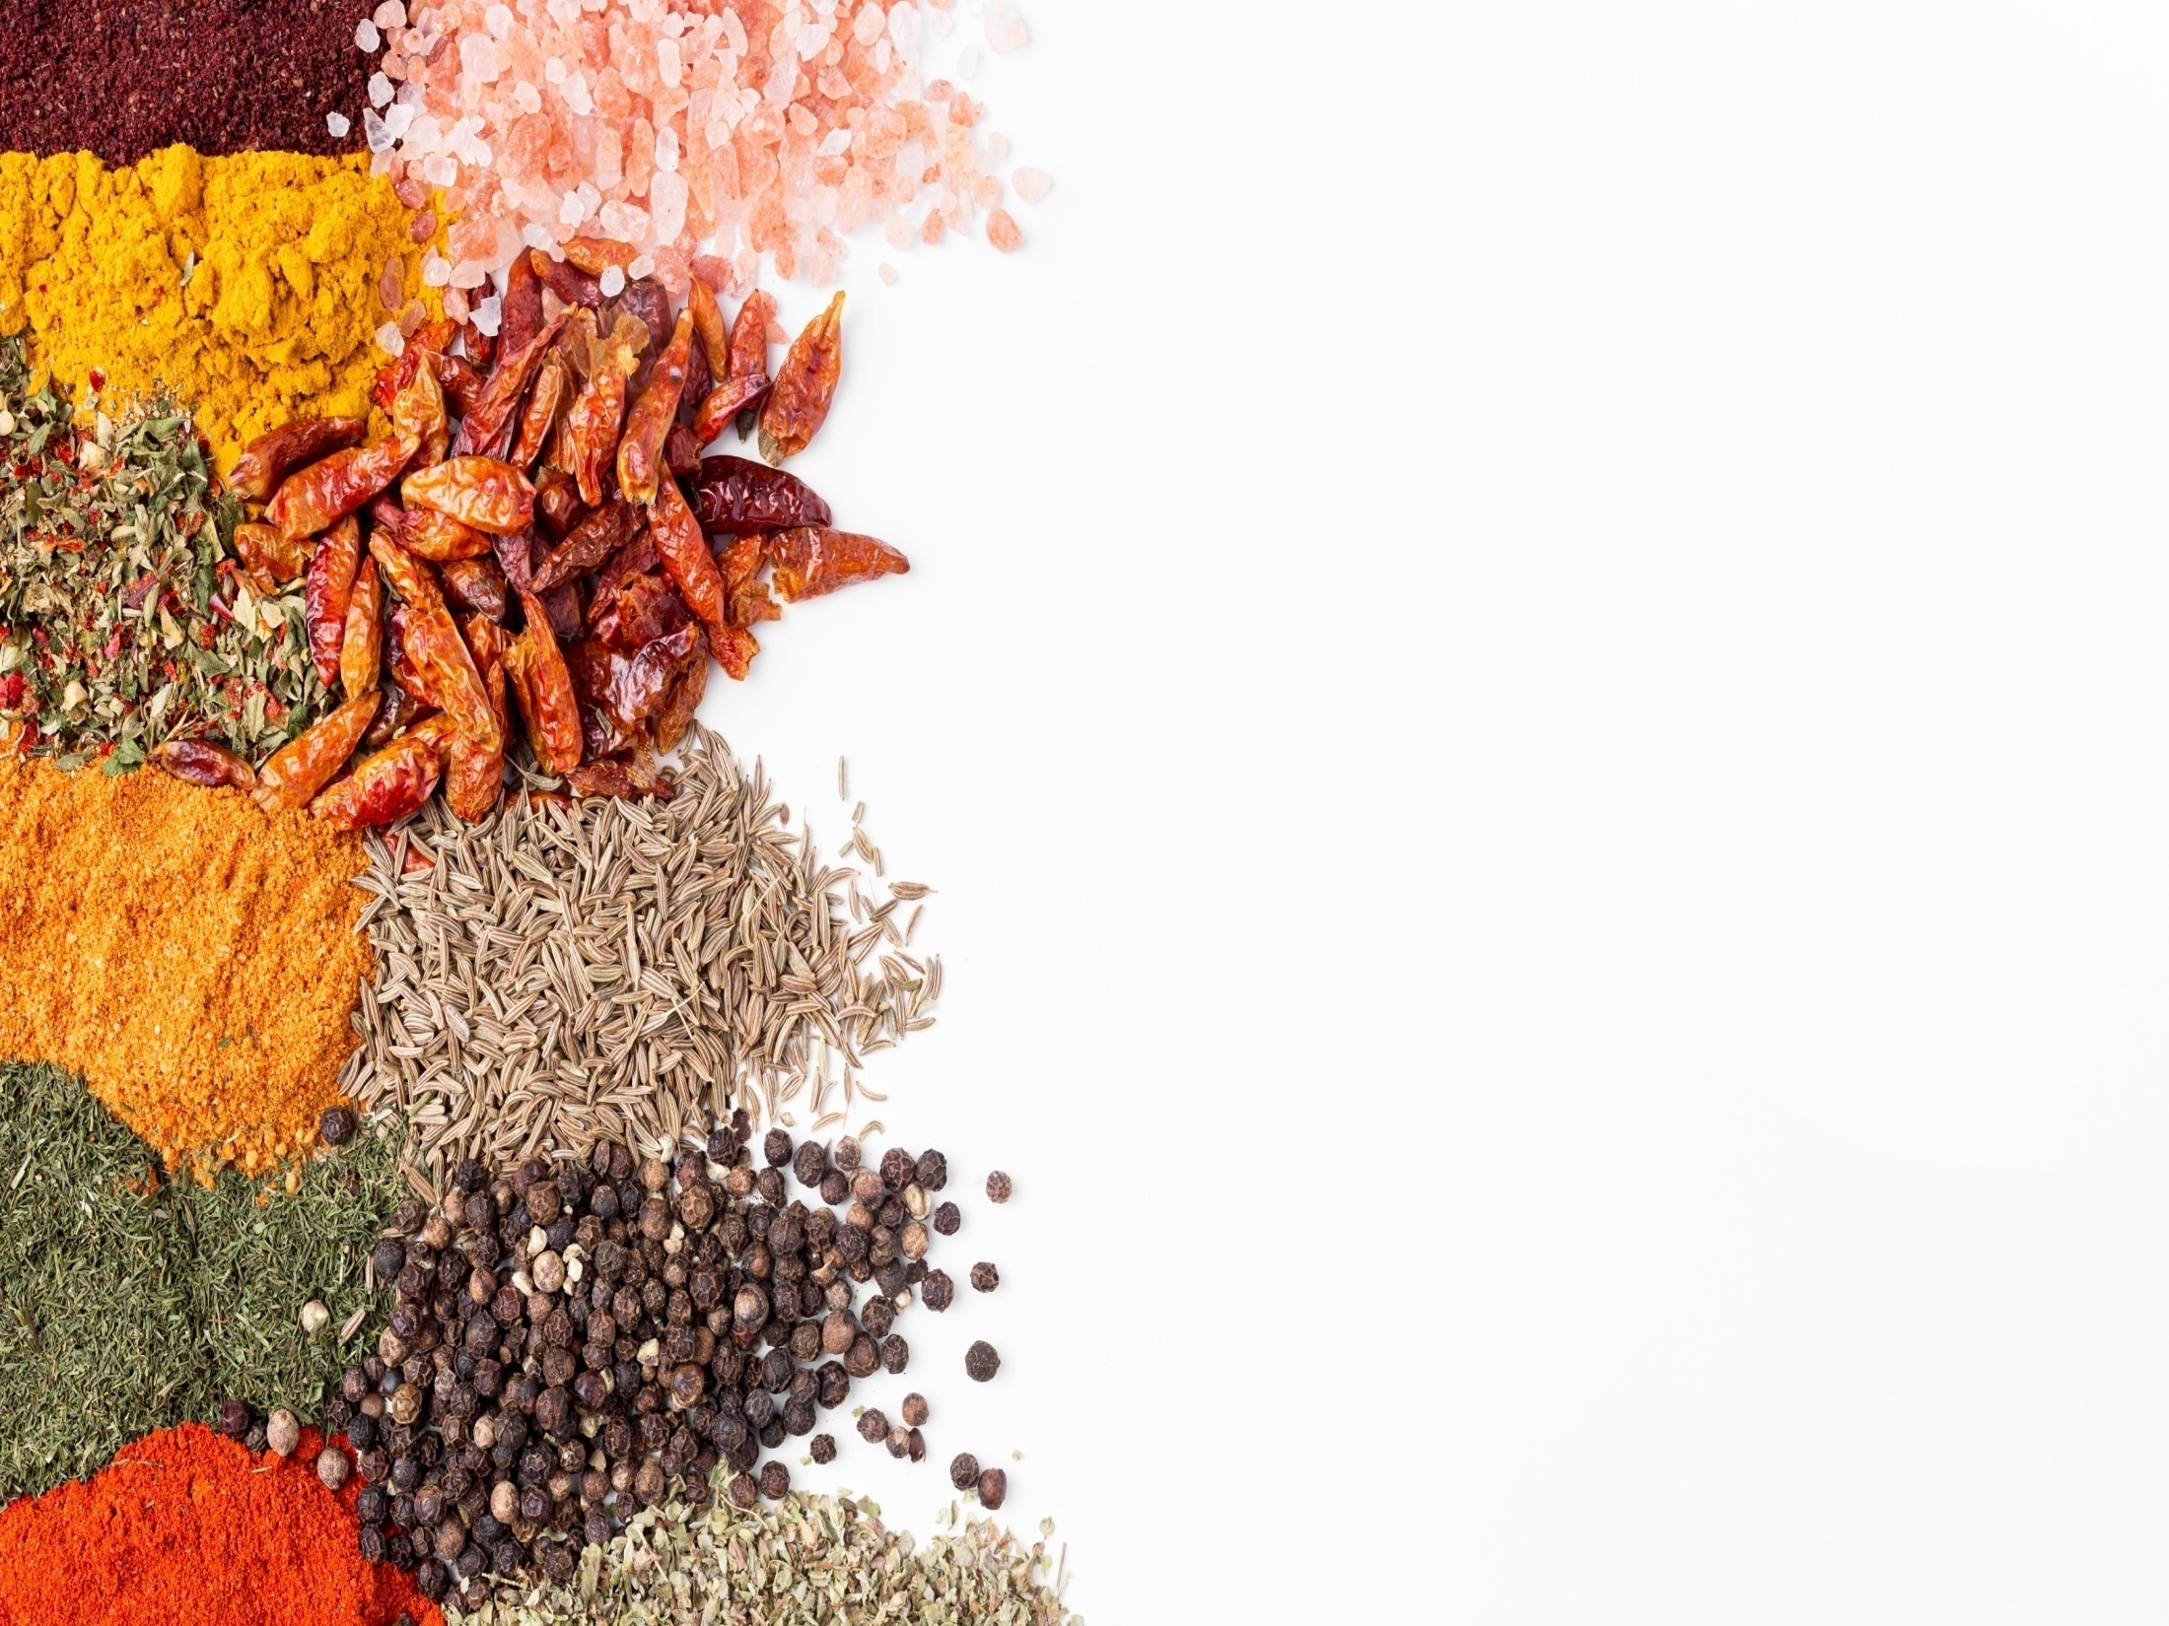
Schedule
The company’s schedule will be as follows :
Company Launch : January 2021
Promotion Online : January ‘21
1st Stall: January Mid ’21
Promotion Offline: January ‘21
First Tourism push: January ‘21
2nd Stall: February ’21
Spring Tour: March ‘21
3rd Stall: Crimea March ‘21

Slide 15
Thank You

